Slide 1
Lecture 06: Memory and IO in x86

Slide 2
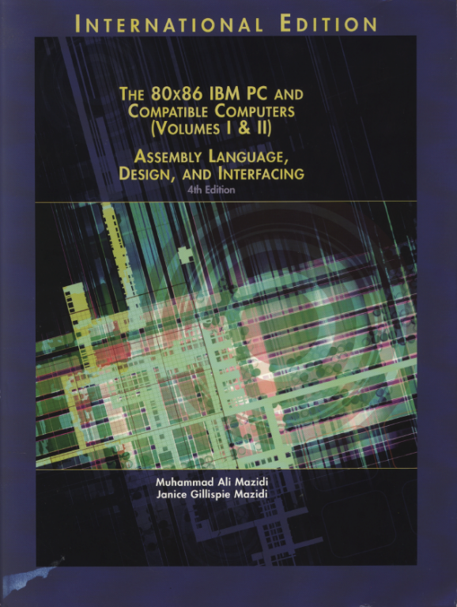
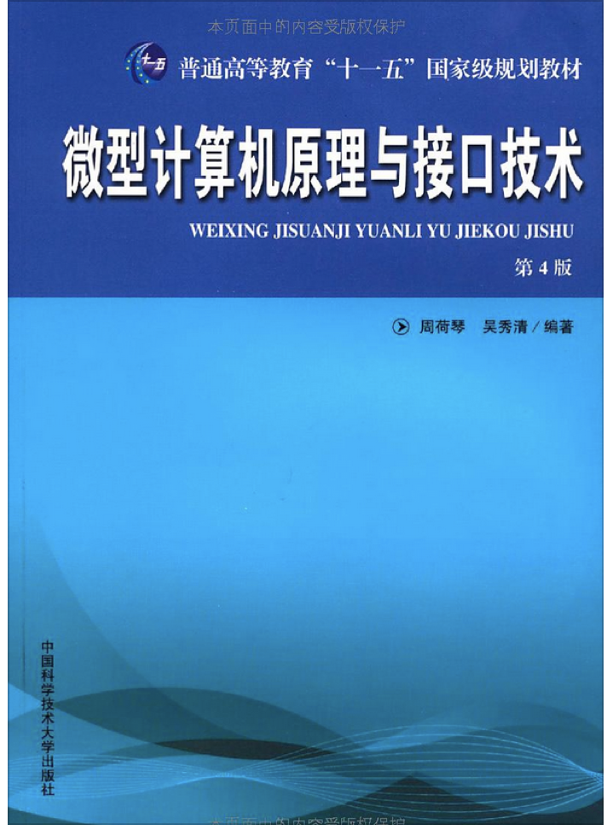
Reference Book:
The 80x86 IBM PC and Compatible Computers
Chapter 10 Memory and Memory Interfacing
Chapter 11 I/O and the 8255
微型计算机原理与接口技术（第四版）
第5章 存储器
第6章 I/O接口和总线

Slide 3
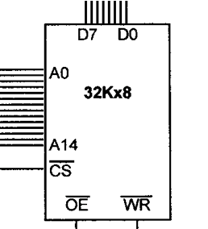
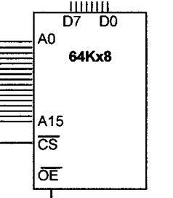
Review on Memory Chips
Key concepts: capacity, organization (the number of locations X the size of addressable unit), access time
Packaging
RAM chip
ROM chip

Slide 4
What to Learn?
How does the 8086 CPU execute an instruction like MOV BX, [1000h]?
What is the difference between executing MOV BX, [1000h] and executing MOV [1001h], BX ?
What is the difference between accessing memory and accessing I/O devices?

Slide 5
Memory Address Decoding
According to your instructions that access memory
E.g., MOV AX, [0012H]
CPU calculates the physical address of the operand and put corresponding signals on the address bus
E.g., if DS=0900H, what’s the PA?
Memory address decoding circuitry locates the specific memory chip that stores the desired data
Examine address decoding using logic gates and 74LS138 decoder chips

Slide 6
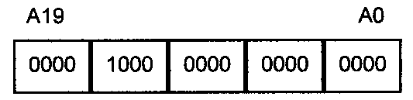
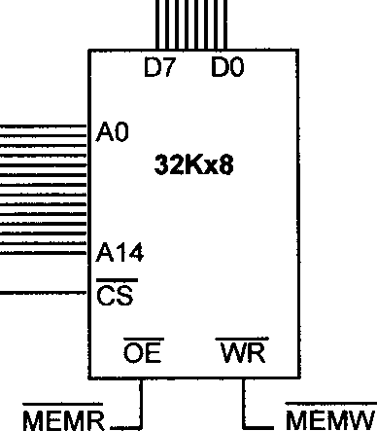
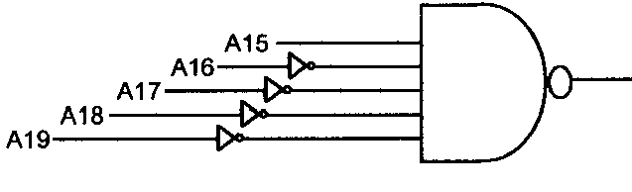
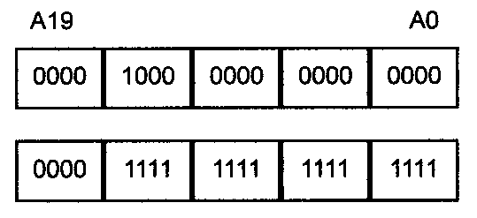


Memory Address Decoding
PA of 0900:0012 = 09012H

Slide 7
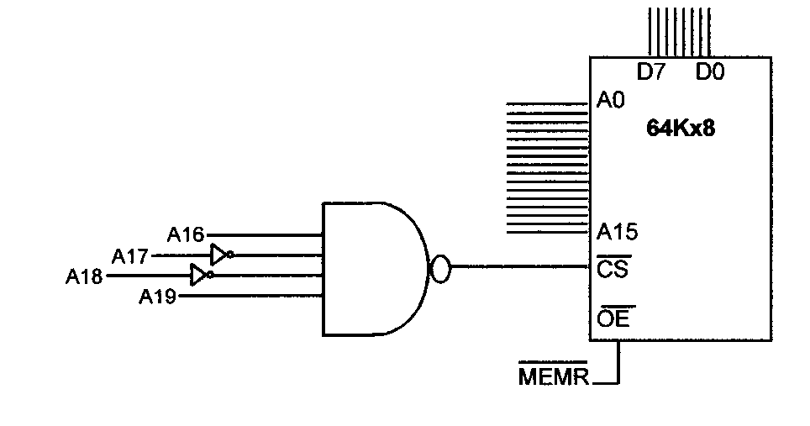

Quiz
What’s the type and the address range of this memory chip?

Slide 8
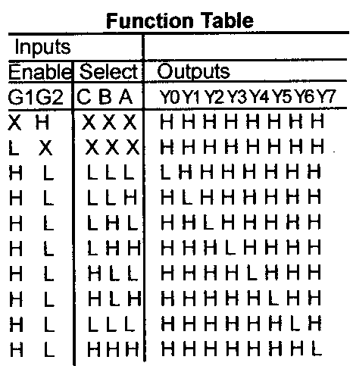
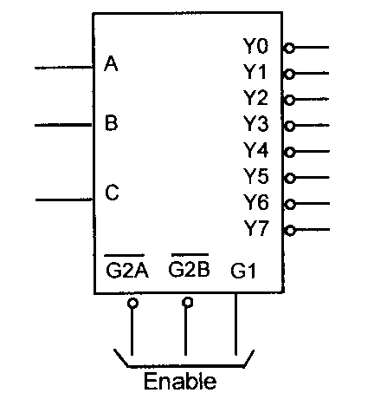

The 74LS138 Decoder Chip

Slide 9
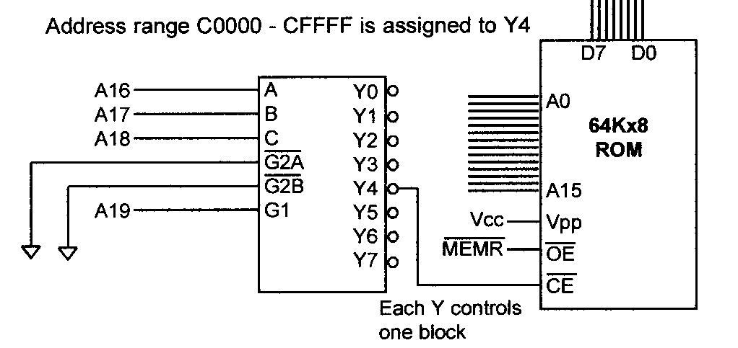
Using 74LS138 to Decode
Grounded

Slide 10
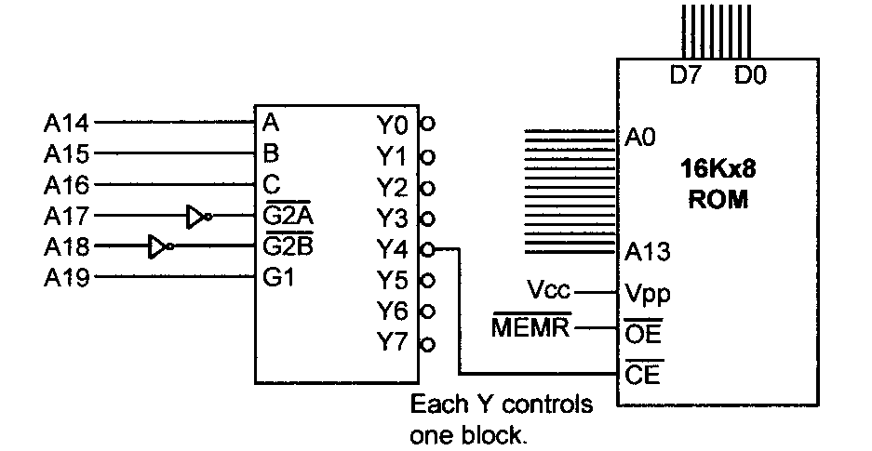


Quiz 2
What’s the address range for Y4 and Y7?

Slide 11
More on Address Decoding
Absolute address decoding
All address lines are decoded
Linear select decoding
Only selected lines are decoded
Cheap
But with aliases: the same memory unit (I/O port) with multiple addresses
Why does this happen?
Notes:
全译码
所有CPU高位地址线均参与对存储单元的译码寻址
低位地址线对芯片内各存储单元的译码寻址
片内译码
高位地址线对存储芯片的译码寻址
片选译码
每个存储单元的地址都是唯一的
不存在地址重复
部分译码
部分高位地址线参与对存储单元的译码寻址
存在地址段内容重叠
每个单元有多个地址

Slide 12
Example 1. In a particular computer, the address range from 0000h to 3FFFh is used for ROM, the range from 4000h to 5FFFh is reserved for future use, and the range from 6000h to 0FFFFh is used for RAM. Assume that the control signals for RAM are CS~ and WE~, and the CPU has 16 address pins (i.e., A15~A0), 8 data pins (i.e., D7~D0), and R/W~ and MREQ~ control signals. Achieve the following requests. (1) draw the address decoding solution using a 74LS138 chip (2) if both ROM and RAM are built with 8K×1 memory chips, try to draw the connection between the CPU and the memory. (3) if ROM is built with 8K×8 memory chips and RAM is built with 4K×8 chips, try to draw the connection between the CPU and the memory. (4) what if ROM is built with 16K×8 memory chips and RAM is built with 8K×8 memory chips?

Slide 13
(1) draw the address decoding solution using a 74LS138 chip
Solution.

Slide 14
(2) if both ROM and RAM are built with 8K×1 memory chips, try to draw the connection between the CPU and the memory.
Solution.

Slide 15
(3) if ROM is built with 8K×8 memory chips and RAM is built with 4K×8 chips, try to draw the connection between the CPU and the memory.
Solution.

Slide 16
(4) what if ROM is built with 16K×8 memory chips and RAM is built with 8K×8 memory chips?
Solution.

Slide 17
Example 2. Assume one computer system needs 512 byte RAM and 512 byte ROM. If RAM is built with 128×8 memory chips and ROM is built with 512×8 memory chips, please specify the address range of each memory chip. Given that RAM chips need CS~ and WE~ control signals, ROM chips need only CS~ control signal, and the CPU has 16 address pins (A15~A0), 8 data pins (D7~D0) and R/W~ and MREQ~ control signals, draw the connection between the CPU and the memory.
Solution. The address range of each memory chip：

Slide 18
As the total volume of the memory is 1K, we need 10 address lines. RAM chips need 7 address lines and ROM chips need 9 address lines.
MREQ
A₇A₈A₉
G2
3-8 decoder
A₁₅~A₀
&
A₆~A₀
R/W
A₈~A₀
CPU
WE A CS
WE A CS
WE A CS
WE A CS
A CS
128x8
128x8
128x8
128x8
512x8
D₇~D₀
D₇~D₀
D₇~D₀
D₇~D₀
D₇~D₀
D₇~D₀

Slide 19
Data Integrity
Checksum byte for ROM
Parity bit for DRAM
CRC for disks and the Internet

Slide 20
Checksum Byte
Check the integrity of a series of bytes
Calculation
Add all bytes together and drop all carries
Take the 2’s complement of the sum
Store the checksum byte together with data
check the integrity by adding data and the checksum together
Then how to prove the integrity of the data?
E.g., 38H, 23H, 33H, 07H, what is the checksum byte?
6BH

Slide 21
Parity bit
Check the integrity of a series of bits (a byte)
even parity: if the number of 1s in the series of bits is odd, then the parity bit is set to 1; otherwise, set to 0, making the total number of 1s even (Data + the parity bit)
odd parity: if the number of 1s in the series of bits is odd, then the parity bit is set to 0; otherwise, set to 1
For PF in 8086, odd parity is used, i.e., if data have even number of 1s, the parity bit is set

Slide 22
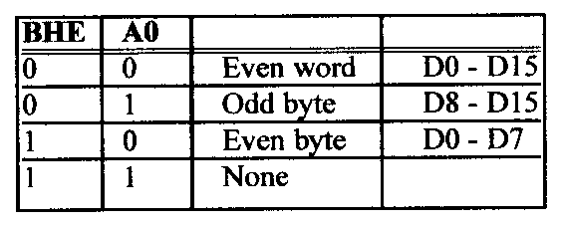
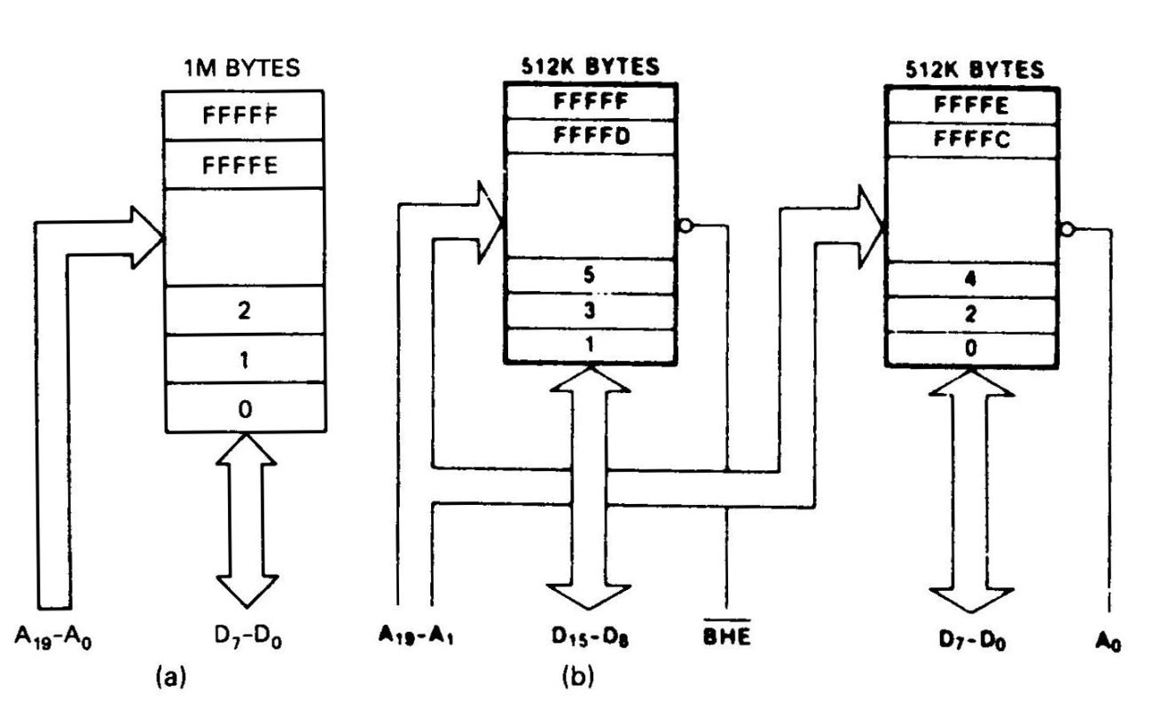
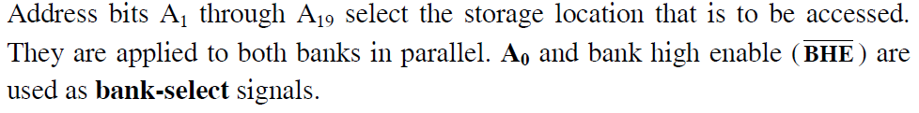
Memory Organization in 8086
Even and odd banks

Slide 23
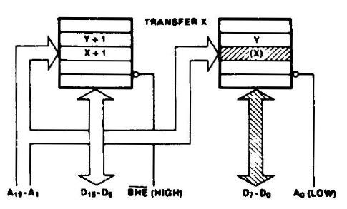
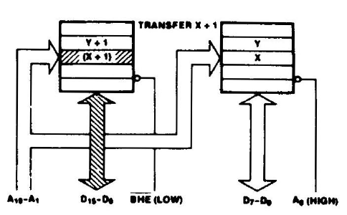
Byte-Memory Operations
Byte-memory operation at even address X
MOV AL, [100h]
Byte-memory operation at odd address X+1
MOV AL, [101h]

Slide 24
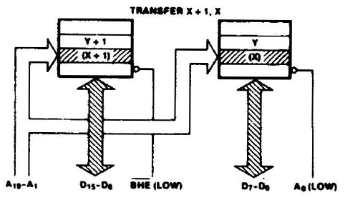

Aligned Word-Memory Operations
Accessing an aligned word at even address X
MOV AX, [100h]

Slide 25
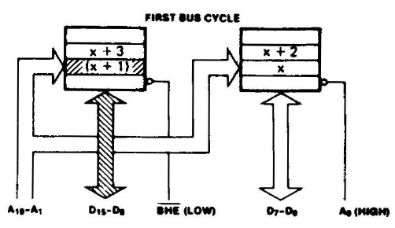
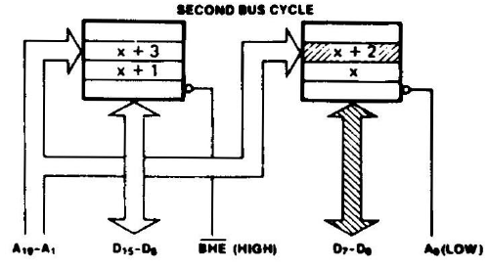
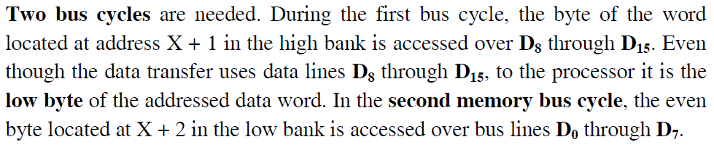
Misaligned Word-Memory Operations
Accessing an misaligned word at odd address X+1
MOV AX, [101h]

Slide 26
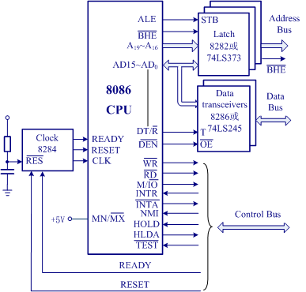
Let's Tell the Stories
Could you possibly tell the complete procedure of the 8086 CPU executing an instruction like MOV BX, [1000h]? What about MOV [1001h], BX?

Slide 27
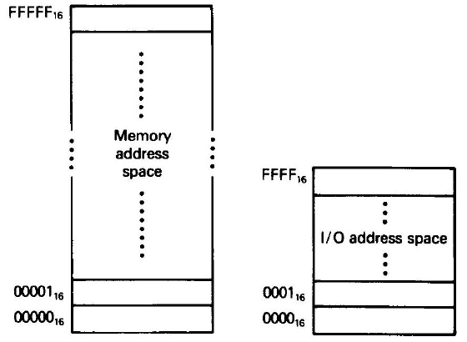
I/O in X86 family – The Other Space from Memory
X86 microprocessors have an I/O space in addition to memory space
Use special I/O instructions accessing I/O devices at ports (i.e., addresses for I/O)
Memory can contain machine codes and data, I/O ports only contain data
Also referred to as peripheral I/O or isolated I/O

Slide 28
I/O Instructions – 8-Bit Instance
Direct I/O instructions:
port# ranges from 00h to 0ffh, 256 ports in total
Indirect I/O instructions:
port# ranges from 0000h to 0ffffh, 65536 ports in all
use a 16-bit address that resides in the DX register
Note: no segment concept for port addresses

Slide 29
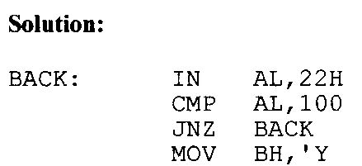
I/O Example
‘Y’

Slide 30
I/O Instructions – 16-Bit Instance
For 16-bit I/O modules
Direct I/O instructions:
port# ranges from 00h to 0ffh, 256 ports in total
IN AX, port# OUT port#, AX
Indirect I/O instructions:
port# ranges from 0000h to 0ffffh, 65536 ports in all
use a 16-bit address that resides in the DX register
MOV DX, port# MOV DX, port#
IN AX, DX OUT DX, AX

Slide 31
Interfacing 8-bit I/O Modules to a 16-bit Data Bus
For 8086, data for even-address ports are carried on data bus D0-D7 and data for odd-address ports are carried on data bus D8-D15

Slide 32
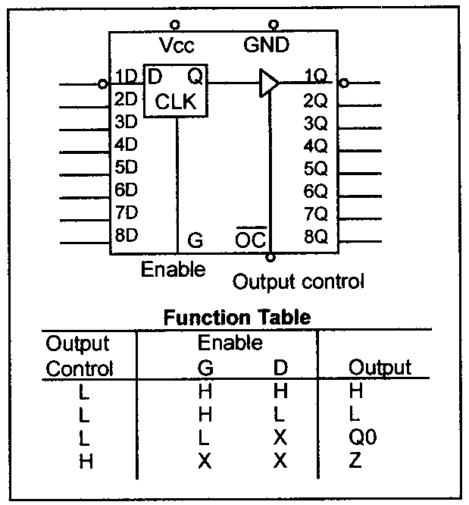
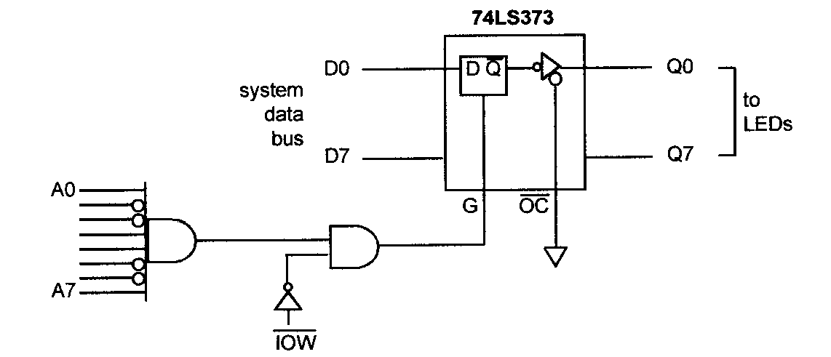

Output Port Design
Latch the data coming from the CPU
Address decoding
What is the address of this port?

Slide 33
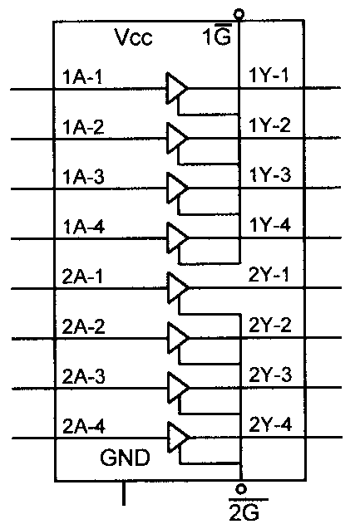
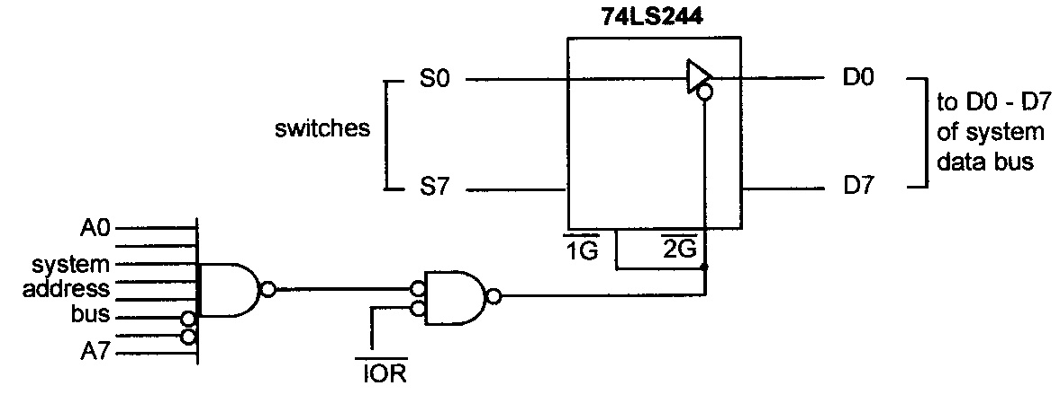
Input Port Design
Use tri-state buffer to connect to system data bus
Address decoding
What is the address of this port?

Slide 34
Assignment
Download and install Proteus and Masm
https://jbox.sjtu.edu.cn/l/xncuCK
Experiment One
https://jbox.sjtu.edu.cn/l/XH2sUu
I and TA will examine your experiment (TBA)

